Slide 1
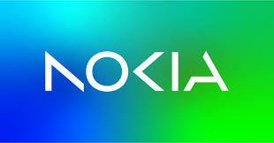
Automation of the Cloud
Farkas Andrei
Ples Serban
Dinescu Denisa

Slide 2

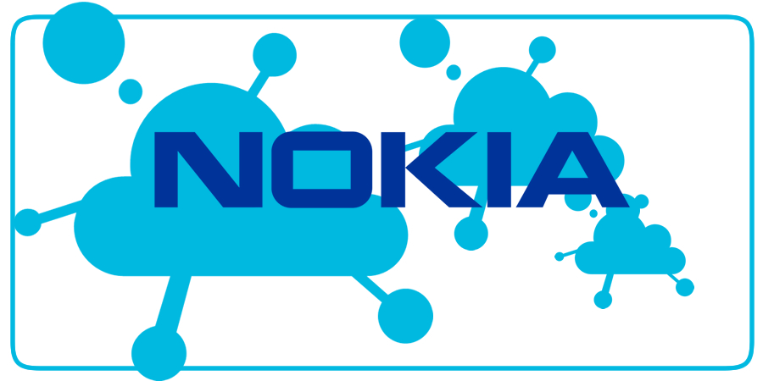
Project Description
The "Automation of the Cloud" project is designed to streamline the management of virtual machines (VMs) and enhance security through effective user access control within a cloud environment. This project is a comprehensive solution that addresses the complexities associated with VM management, providing a user-friendly interface that simplifies interactions and ensures robust access control mechanisms. The primary goal is to deliver a platform that not only facilitates VM operations but also secures access and automates various administrative tasks.

Slide 3
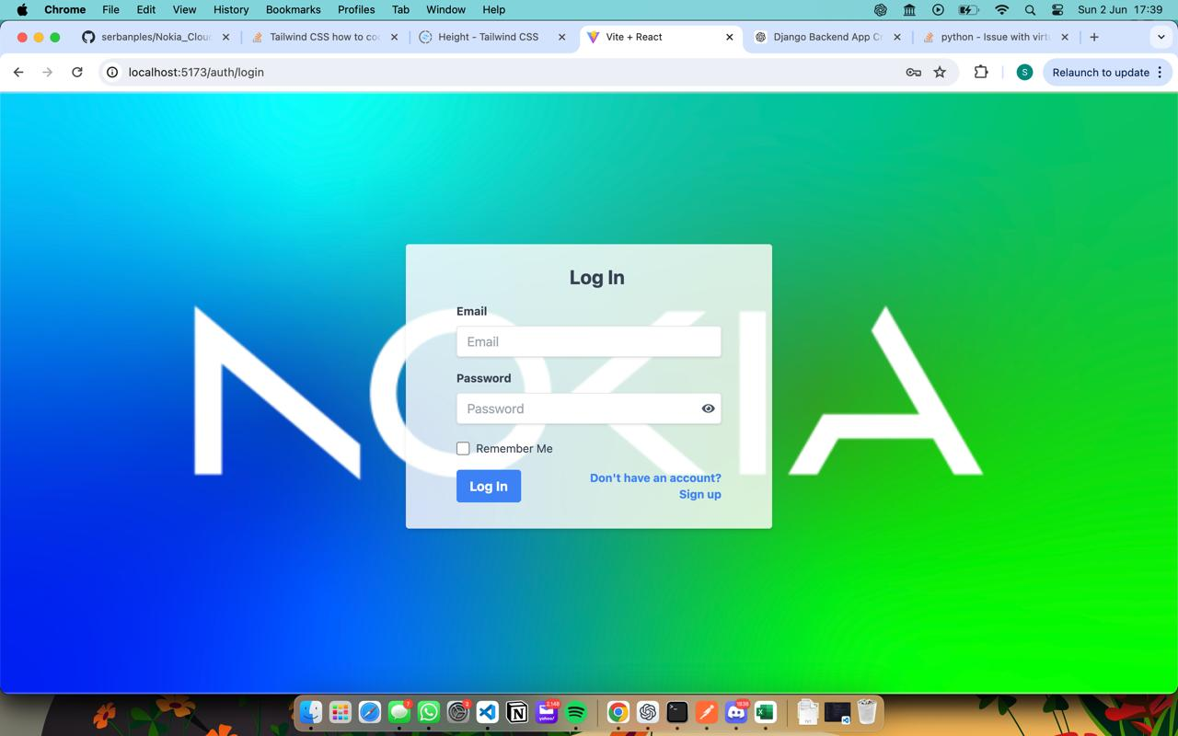
Project Overview
Purpose:
The project focuses on managing virtual machines (VMs) and controlling user access within a cloud environment.
Objectives:
To simplify VM management and enhance security by providing a user-friendly interface for VM interactions and access controls.
Key Features:
User Authentication: Secure login and signup functionality.
Dashboard: Overview of available VMs and their status.
VM Management: Create, update, delete, and connect to VMs.
Access Control: Assign and revoke user access to specific VMs.
Technologies Used:
Built using Flask for the backend, React for the frontend, and OAuth2 for authentication.

Slide 4
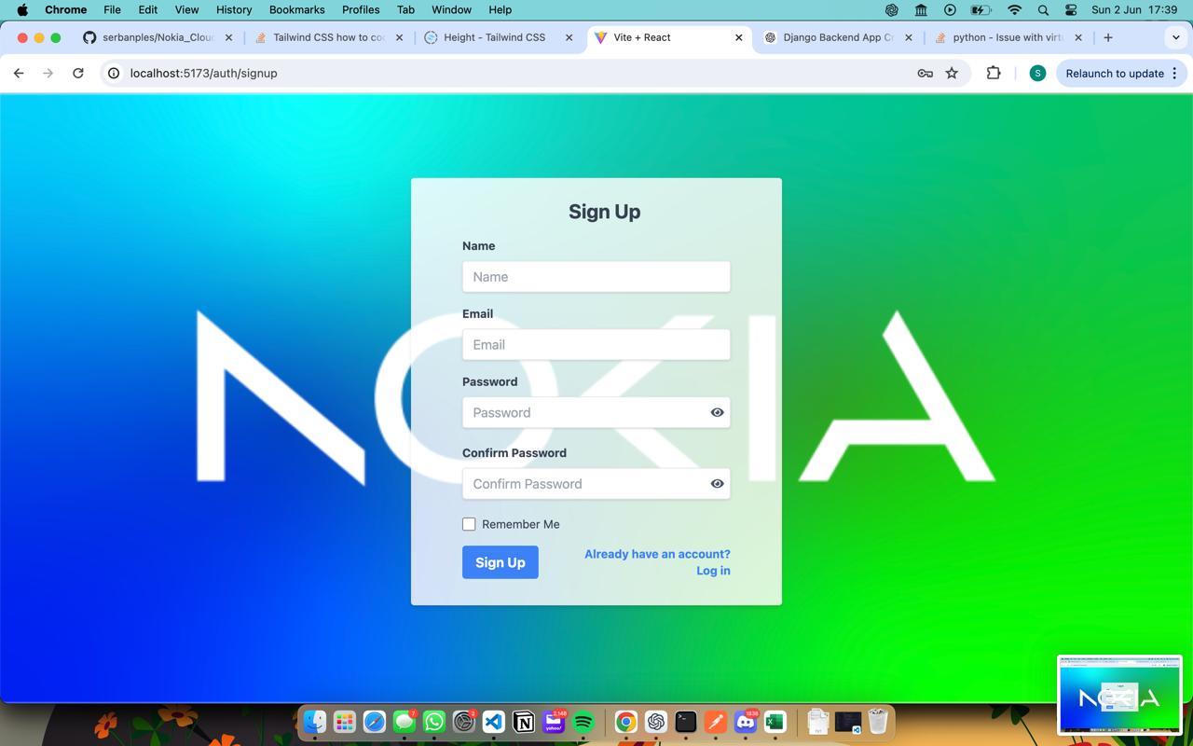
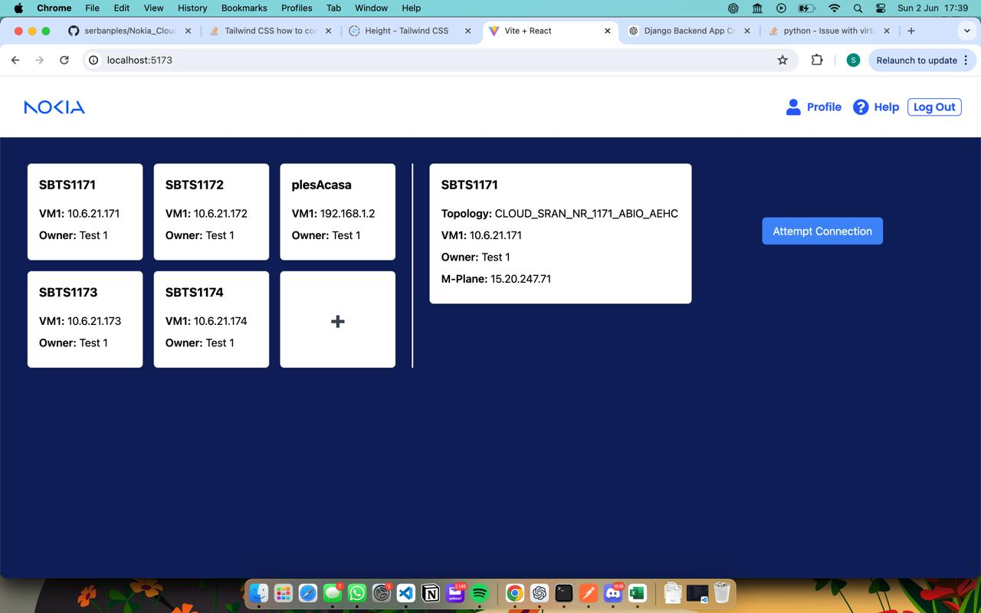
Key Features
1. User Authentication:
Secure login and signup functionality.
Utilizes OAuth2 for secure authentication.
Ensures only authorized users can access the system.
2. Dashboard:
Provides an overview of all available VMs and their statuses.
Allows users to quickly see which VMs are active, inactive, or need attention.

Slide 5
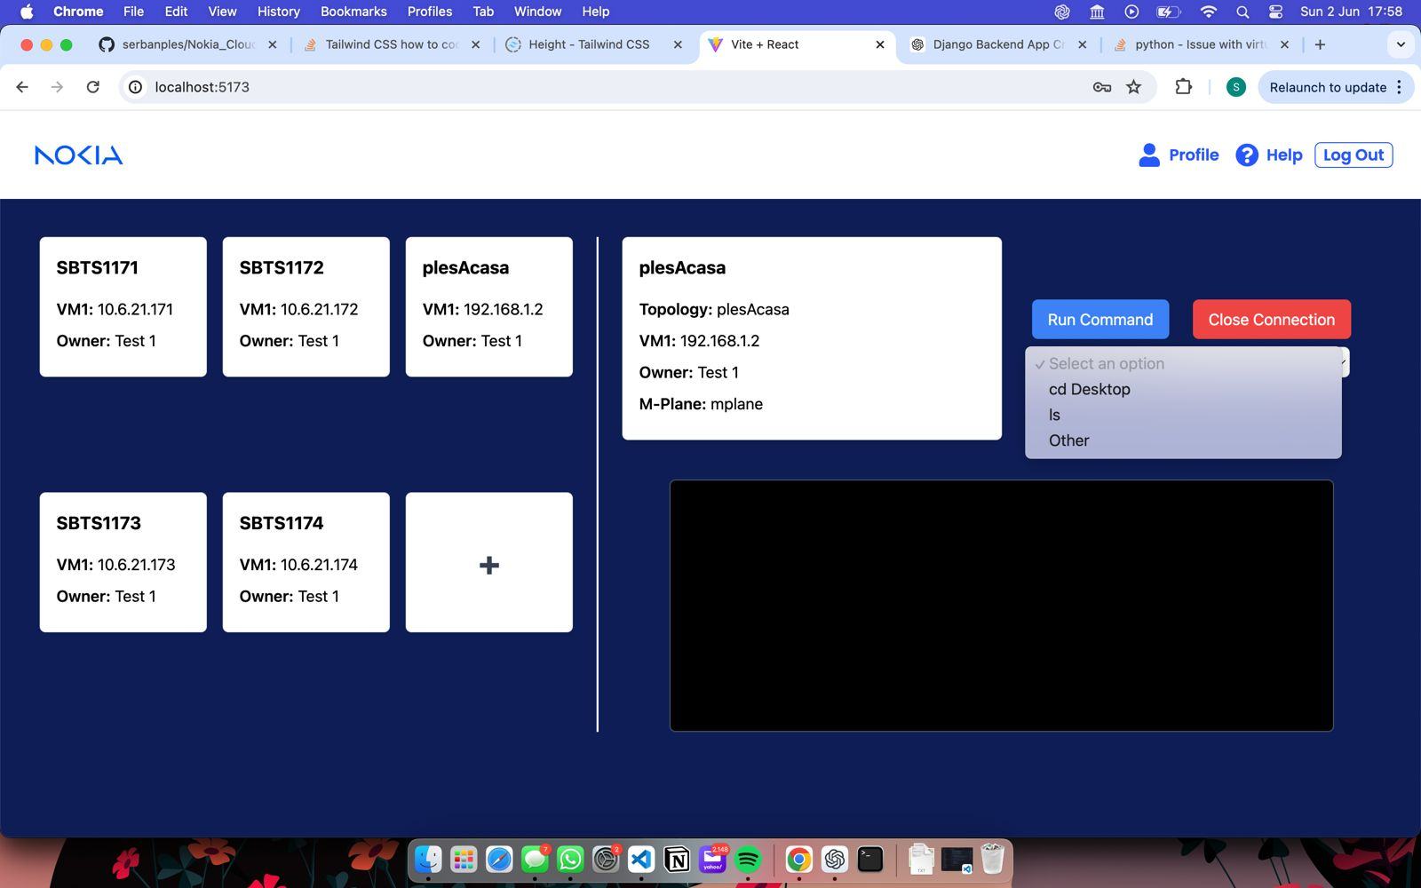
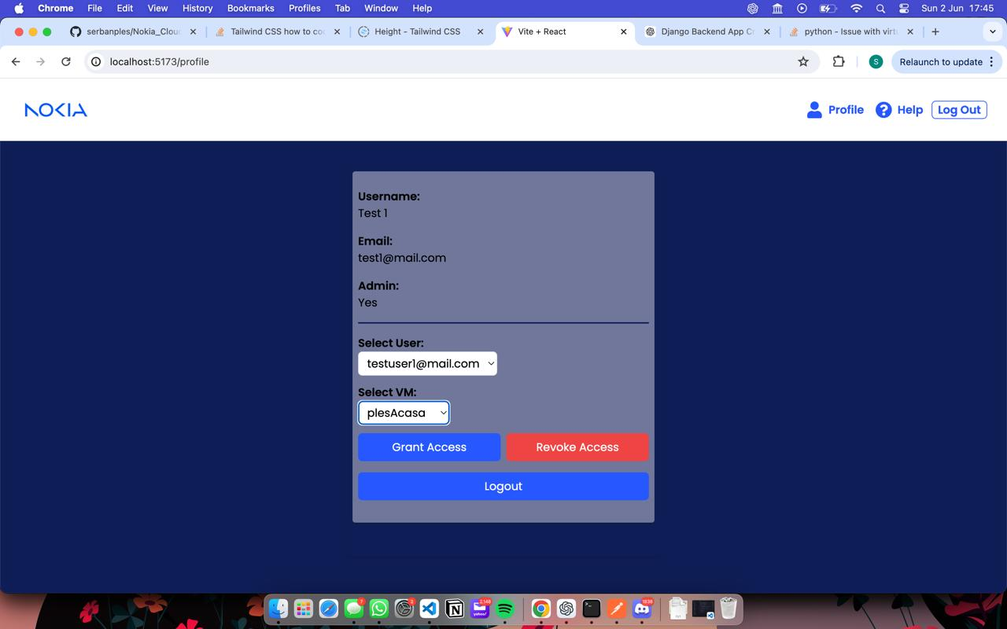
Key Features
3. VM Management:
Users can create, update, delete, and connect to VMs.
Simplifies the management of VMs through a user-friendly interface.
Provides detailed information about each VM, such as IP addresses, status, and owner.
. Access Control:
Admins can assign and revoke user access to specific VMs.
Role-based access control to ensure security and proper access management.
Detailed logs of access requests and permissions changes.

Slide 6
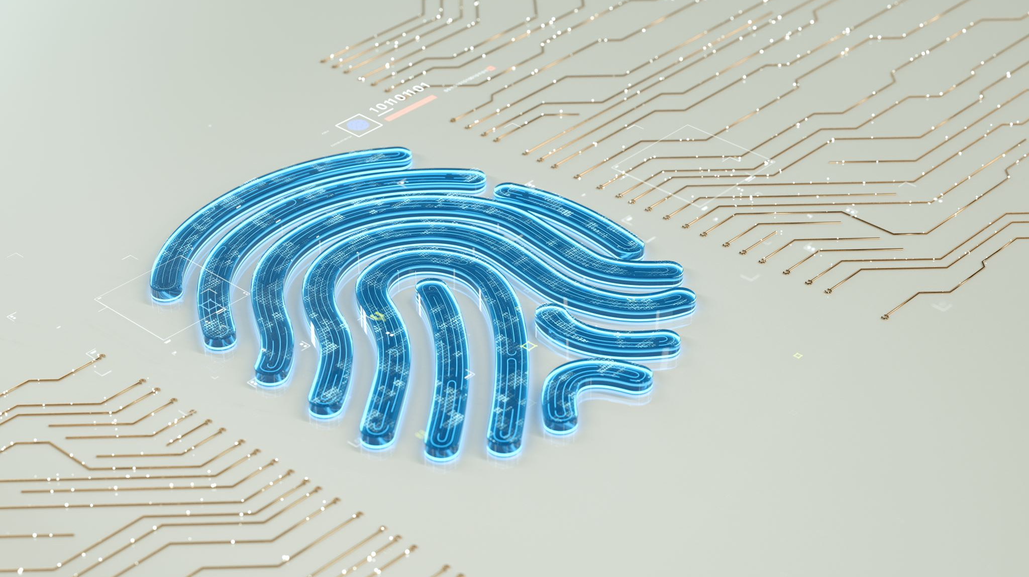
The Most challenging parts
1. Authentication and Authorization:
Challenge:
Implementing a secure and efficient authentication mechanism using OAuth2.
Ensuring proper role-based access control for different user types.
Solution:
Integrated OAuth2 for secure login and signup processes.
Developed a role-based access control system to manage permissions effectively.
2. Real-Time Updates:
Challenge:
Providing real-time updates to users without causing performance issues.
Ensuring data consistency across the platform.
Solution:
Utilized WebSockets to deliver instant updates on VM statuses and other critical information.
Implemented data validation and synchronization techniques to maintain consistency.
3. User Interface Design:
Challenge:
Creating a user-friendly interface that caters to both novice and experienced users.
Balancing functionality with simplicity in design.
Solution:
Conducted user testing to gather feedback and iterate on the design.
Employed a modular design approach to ensure scalability and ease of use.

Slide 7

How things work
1. User Authentication and Authorization:
Process:
Users sign up or log in using OAuth2.
The system validates user credentials and assigns appropriate roles.
Users gain access to the platform based on their roles and permissions.
Visual: Diagram showing the flow of the authentication process, from login/signup to role assignment.
2. VM Management:
Process:
Users interact with the dashboard to create, update, delete, or connect to VMs.
The backend processes these requests and updates the VM statuses accordingly.
Real-time updates ensure users see the latest VM status without refreshing the page.
Visual: Flowchart illustrating the VM management process, including user actions and backend responses.
3. Real-Time Updates and Notifications:
Process:
WebSockets handle real-time communication between the server and the client.
Users receive instant notifications about important events, such as access grants and VM status changes.
Notifications are customizable and can be delivered in-app or via email.
Visual: Diagram showing the real-time update flow, including WebSocket connections and notification delivery.

